Slide 1
DIJKSTRA'S ALGORITHM
By Laksman Veeravagu and Luis Barrera

Slide 2

THE AUTHOR: EDSGER WYBE DIJKSTRA
"Computer Science is no more about computers than astronomy is about telescopes."
http://www.cs.utexas.edu/~EWD/

Slide 3
EDSGER WYBE DIJKSTRA
- May 11, 1930 – August 6, 2002
- Received the 1972 A. M. Turing Award, widely considered the most prestigious award in computer science.
- The Schlumberger Centennial Chair of Computer Sciences at The University of Texas at Austin from 1984 until 2000
- Made a strong case against use of the GOTO statement in programming languages and helped lead to its deprecation.
- Known for his many essays on programming.

Slide 4

SINGLE-SOURCE SHORTEST PATH PROBLEM
Single-Source Shortest Path Problem - The problem of finding shortest paths from a source vertex v to all other vertices in the graph.

Slide 5
DIJKSTRA'S ALGORITHM
Dijkstra's algorithm - is a solution to the single-source shortest path problem in graph theory.
Works on both directed and undirected graphs. However, all edges must have nonnegative weights.

Slide 6
Approach: Greedy
Greedy is an algorithmic paradigm that builds up a solution piece by piece, always choosing the next piece that offers the most obvious and immediate benefit. So the problems where choosing locally optimal also leads to global solution are best fit for Greedy
Input: Weighted graph G={E,V} and source vertex v∈V, such that all edge weights are nonnegative
Output: Lengths of shortest paths (or the shortest paths themselves) from a given source vertex v∈V to all other vertices

Slide 7
DIJKSTRA'S ALGORITHM - PSEUDOCODE
dist[s] ←0 (distance to source vertex is zero)
for all v ∈ V–{s}
do dist[v] ←∞ (set all other distances to infinity)
S←∅ (S, the set of visited vertices is initially empty)
Q←V (Q, the queue initially contains all vertices)
while Q ≠∅ (while the queue is not empty)
do u ← mindistance(Q,dist) (select the element of Q with the min. distance)
S←S∪{u} (add u to list of visited vertices)
for all v ∈ neighbors[u]
do if dist[v] > dist[u] + w(u, v) (if new shortest path found)
then d[v] ←d[u] + w(u, v) (set new value of shortest path)
(if desired, add traceback code)
return dist

Slide 8
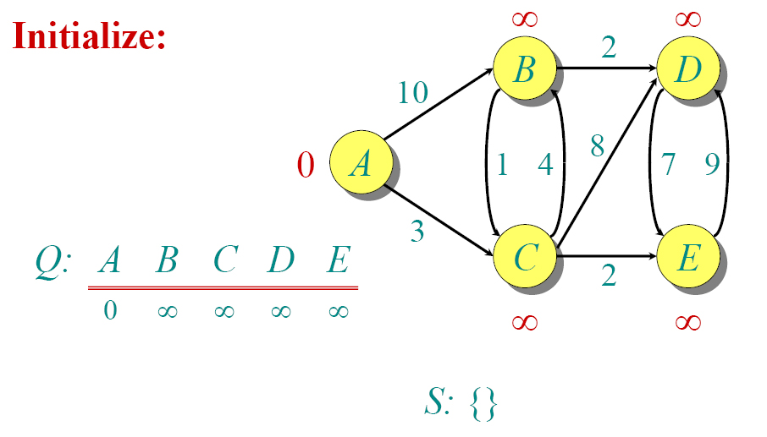
DIJKSTRA ANIMATED EXAMPLE

Slide 9

DIJKSTRA ANIMATED EXAMPLE

Slide 10

DIJKSTRA ANIMATED EXAMPLE

Slide 11

DIJKSTRA ANIMATED EXAMPLE

Slide 12

DIJKSTRA ANIMATED EXAMPLE

Slide 13

DIJKSTRA ANIMATED EXAMPLE

Slide 14

DIJKSTRA ANIMATED EXAMPLE

Slide 15

DIJKSTRA ANIMATED EXAMPLE

Slide 16

DIJKSTRA ANIMATED EXAMPLE

Slide 17

DIJKSTRA ANIMATED EXAMPLE

